Slide 1

Intro to R Shiny
Warren Hearnes April 29, 2021

Slide 2

My Background
Self-taught R user w/7 years exp. in the language
Not an expert in Shiny, building UIs, or creating visualizations, but definitely enjoy turning prototypes into workable solutions
Interests include:
Machine learning
Reinforcement learning
Optimization
Data visualization
Simulation
Fuzzy sets
SVP, Analytics & Data Science at Cardlytics
https://www.linkedin.com/in/warrenhearnes/
Been in ATL for past 29 years for grad school, then on to work and raise a family:
Georgia Tech (MS OR, PhD IE), 1992-1999
Lucent Technologies, 1998-2003
UPS, 2003-2011
The Home Depot, 2011
Cardlytics, 2011-present

Slide 3
Presentation Outline
Why I use Shiny apps
Some notable differences between R and an R Shiny app
Building a very simple app
Review Input and Output types
Review interesting code demos in Shiny Gallery
Review a more complex app I created
Deployment options
Additional resources
Ask questions at any time!

Slide 4
Why I use Shiny apps…

Slide 5
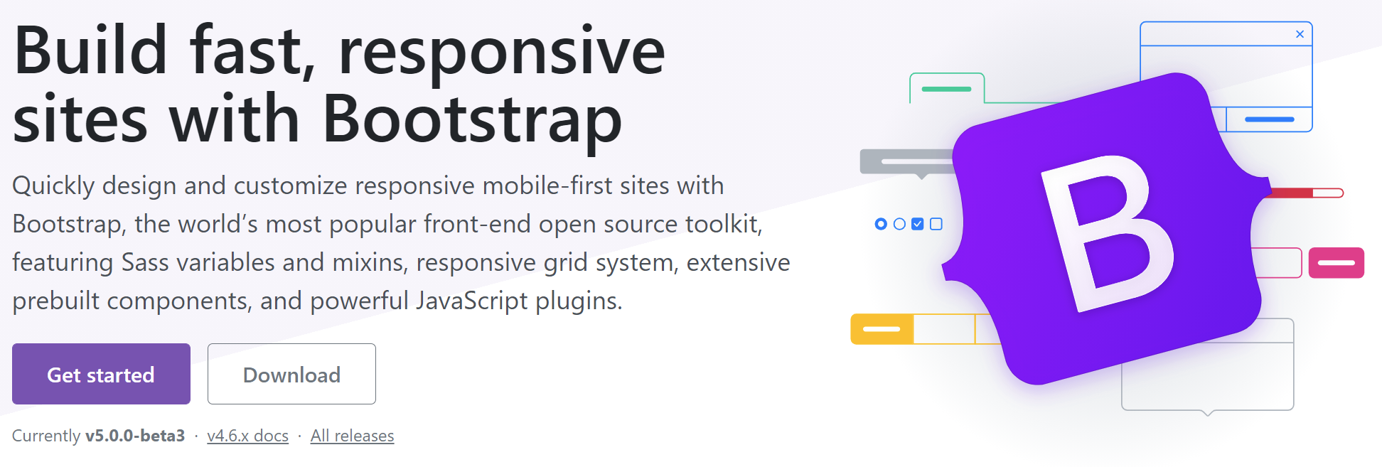
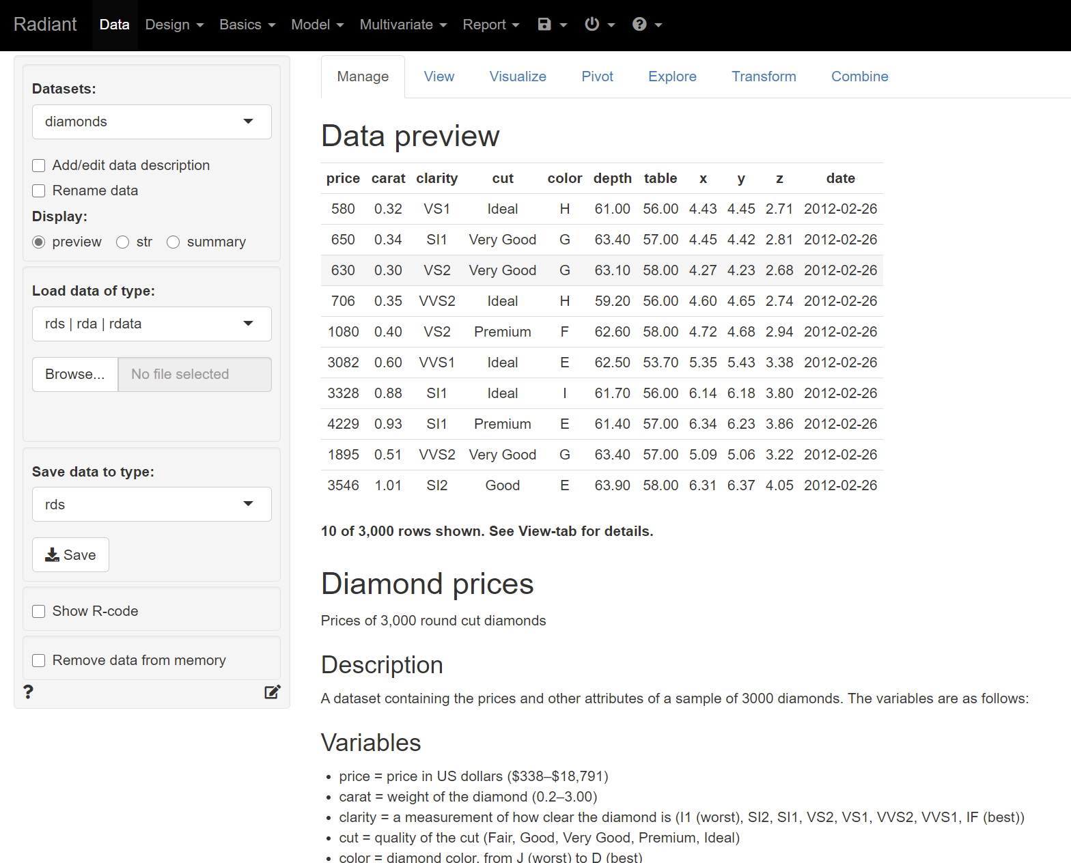
Shiny provides an intuitive graphical UI to R
Turn existing R code (with modifications that we’ll discuss) into web-based applications built on Bootstrap JavaScript
Create interactive charts and tables that help with exploratory analysis
Let users learn by visualizing the impact of changing parameters or assumptions
Create intuitive/familiar GUI apps that leverage HTML and Javascript without having to know how to code in either one
Example: Shiny - Radiant - A shiny app for statistics and machine learning (rstudio.com)

Slide 6
Some of the notable differences in a Shiny app

Slide 7
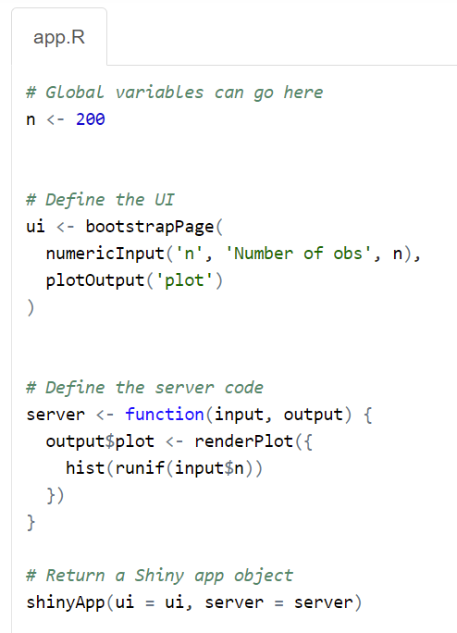
Separate the UI from the underlying functions
Shiny applications have two components:
UI object – defines how the web page will be laid out and what kind of input and output objects will be displayed
Server function – defines functions that manipulate inputs and create output objects (e.g., plots, etc.)
These can be either two separate files (ui.R and server.R) or a single file called app.R
Both are passed to a single function called shinyApp (implicitly in the two-file version or explicitly in the single-file version)
Source: Shiny - Single-file shiny app (rstudio.com)

Slide 8
Reactivity. It’s like magic (only it isn’t)!
In a standard R script, you load data/set variables and then the code to get new charts/tables/analysis.
In a Shiny app in a web-based environment, there is no button. The code is ‘always on’ and listening for changes. When a change happens, then reactivity causes the right parts of your R code to be re-executed and the charts/tables/analysis that depend on the data or variable that has changed are updated.
So, how does that work exactly?
Reactivity is what makes the Shiny app responsive to changes in any of the inputs. The JavaScript libraries are ‘listening’ for changes and the Shiny app code tells the system what to do when a change happens.
“You don’t need to know how reactivity occurs to use it … but understanding reactivity will make you a better Shiny programmer.”
https://shiny.rstudio.com/articles/understanding-reactivity.html

Slide 9
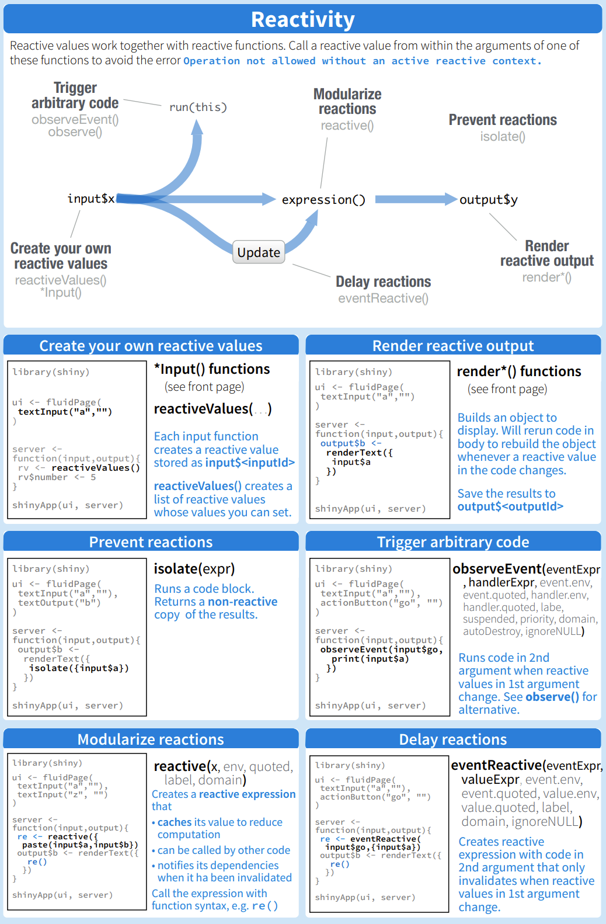
Great resource for reference is the Shiny Cheat Sheet at rstudio.com
Fundamental topics:
Using *Input() and reactiveValues() to set values
Using render*() functions to build objects that can be displayed
Use observeEvent() to trigger code at a specific time (e.g., when a ‘Submit’ button is clicked)
Use reactive() to create an expression that caches a value for later use but will recalculate when any of the reactive values that it depends on are changed
Delay or prevent reactions with isolate() or eventReactive()
Times you may want to use some advanced reactivity control:
When several parameters need to be changed before running the underlying code
When the underlying code takes a noticeable time to run
When changes to the parameters need to compute in a specific order
Source: https://shiny.rstudio.com/images/shiny-cheatsheet.pdf

Slide 10
Building a Simple App

Slide 11

Learn from examples
Want to reiterate – I am not an R Shiny expert!
What follows are some of the examples that I reviewed as I made my first R Shiny apps
After the examples, I’ll show an app I created
My method of learning how to code in a new language:
Start with a specific project in mind
Break the project into chunks
Complete each chunk – CRAN docs, Stack Overflow, etc.
Test! Test! Test!

Slide 12
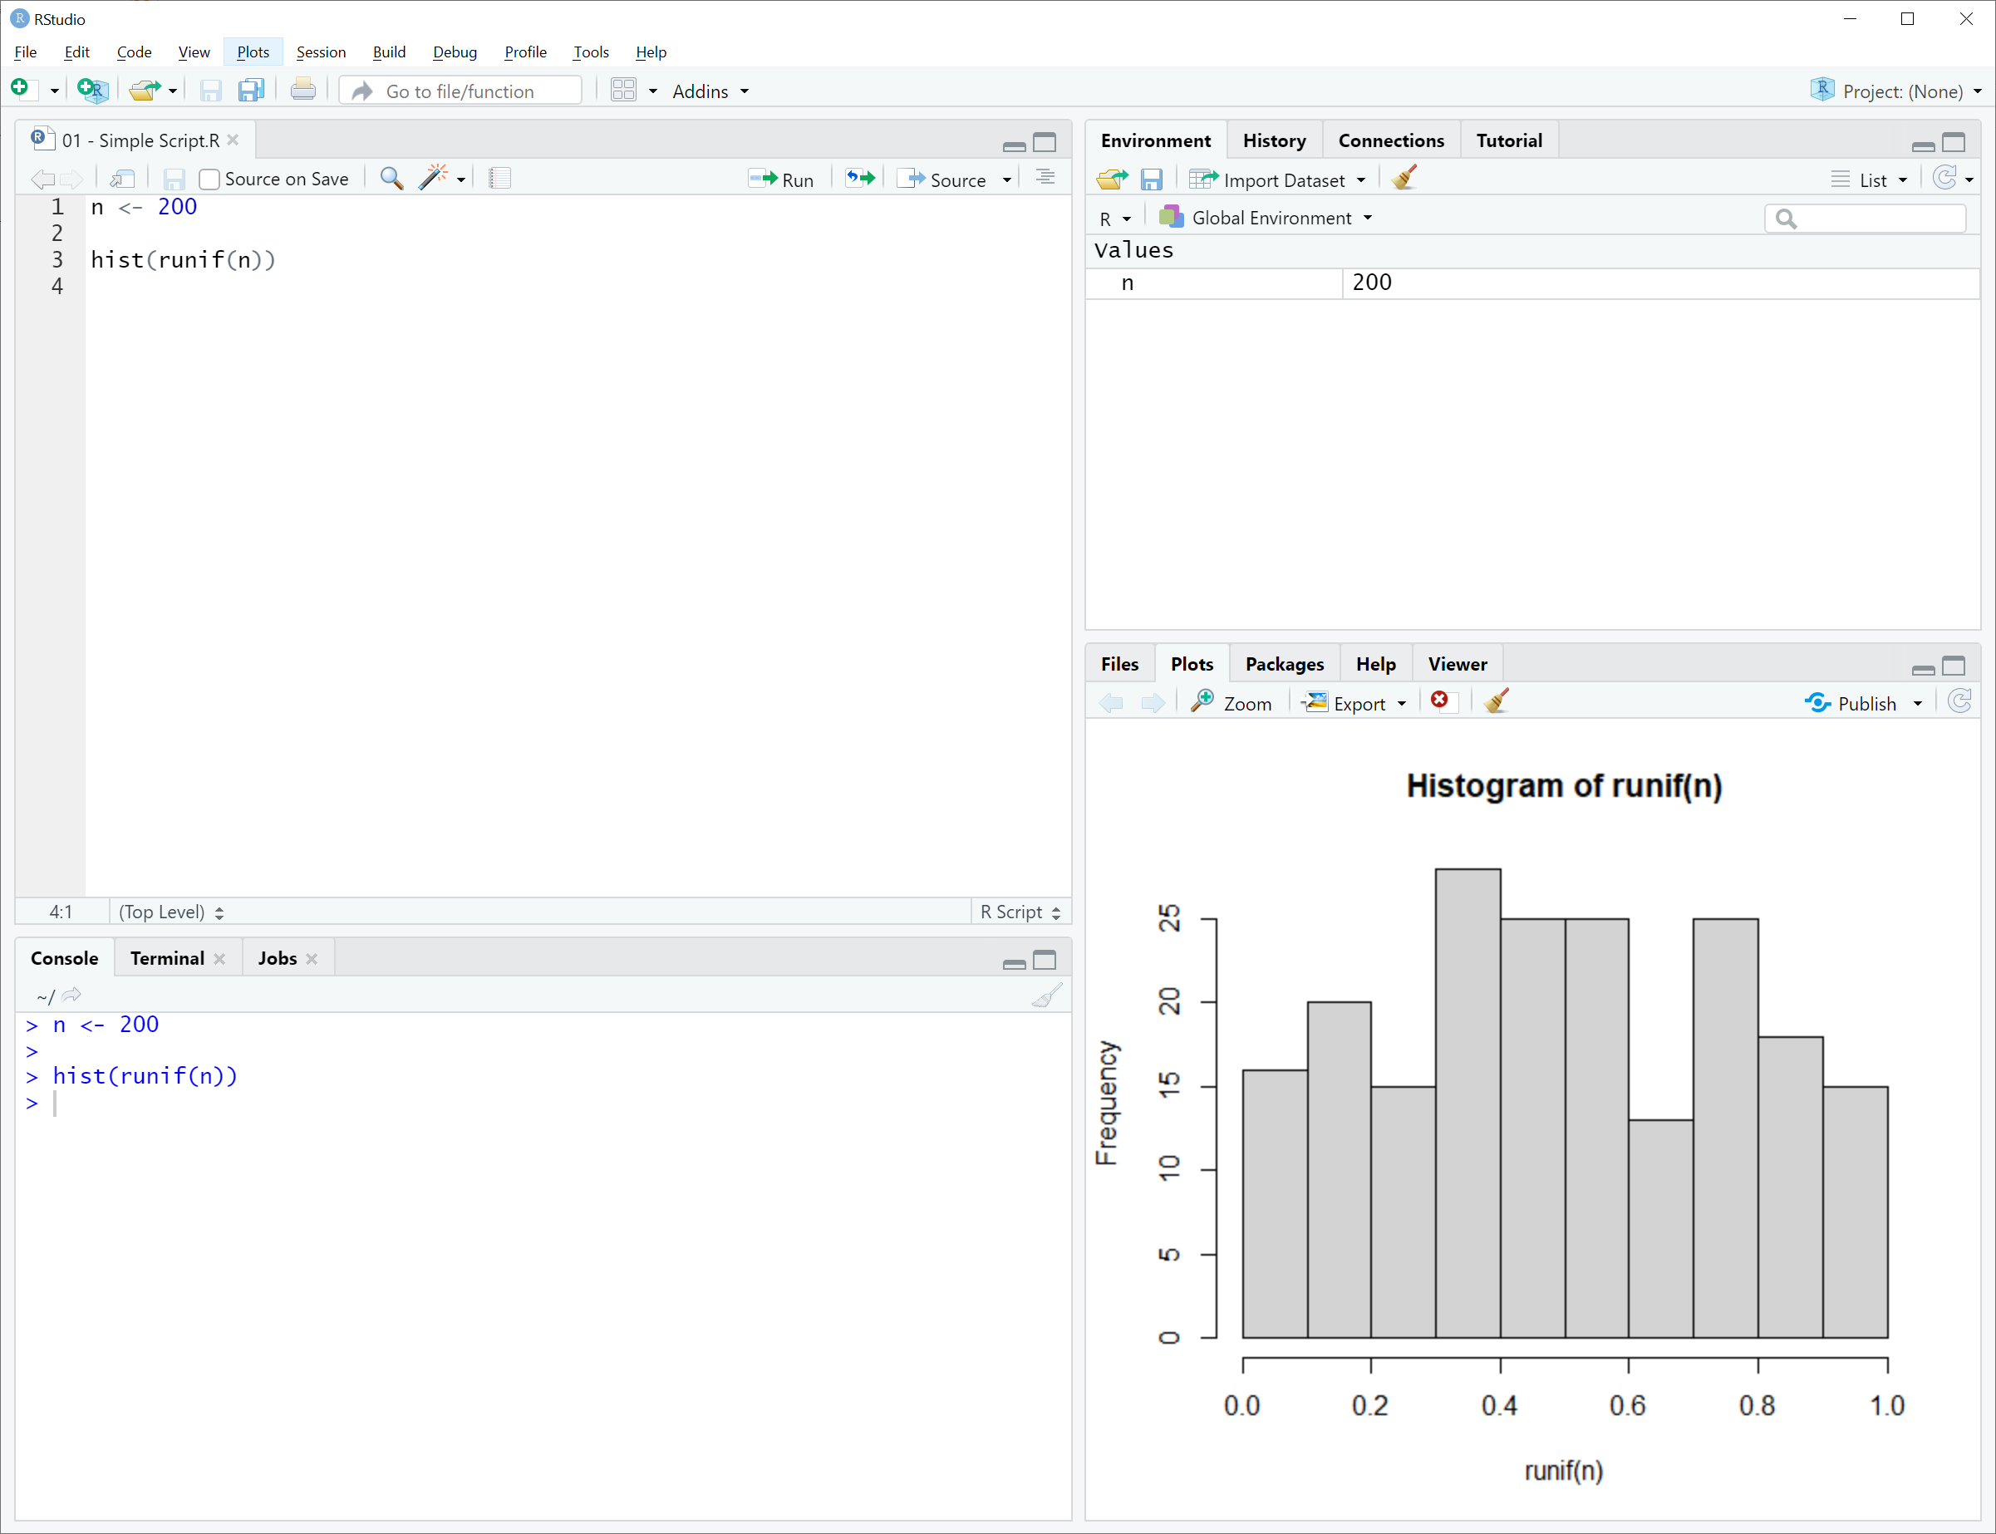
Let’s look back at the simple demo from RStudio for a single-file app
Objective is to plot the histogram of n uniform random numbers
Start with the R script:
To run with different values of n, the user must edit and re-run each time.
Source: Shiny - Single-file shiny app (rstudio.com)

Slide 13
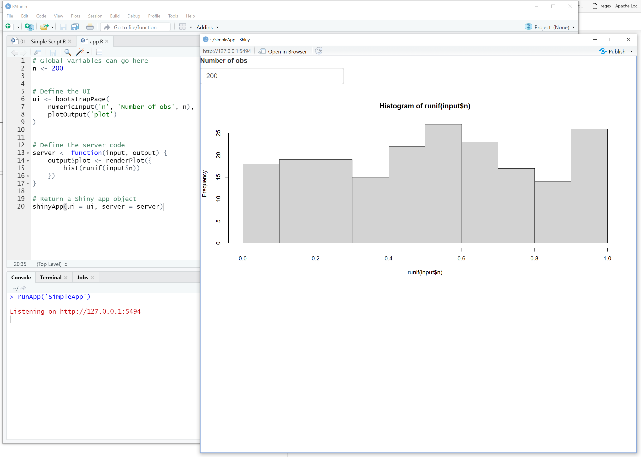
Connecting the input and output objects
The UI consists of a bootstrapPage defined as the list of input and output objects:
Numeric input value ‘n’
Output plot named ‘plot’
The server function consists of a single function that takes the ‘n’ input and renders a histogram as an output ‘plot’:
Note input and output arguments to the function
Note the corresponding input$ and output$ prefixes to the named variables in the UI object – that is what makes the reactivity magic happen!
The app is running on a local web server run by RStudio on port 5494
Source: Shiny - Single-file shiny app (rstudio.com)

Slide 14
Switch to RStudio to show Simple App examples:
R Script
Shiny App
Final code in browser (F12 to Developer Tools)

Slide 15
Input and Output Types

Slide 16
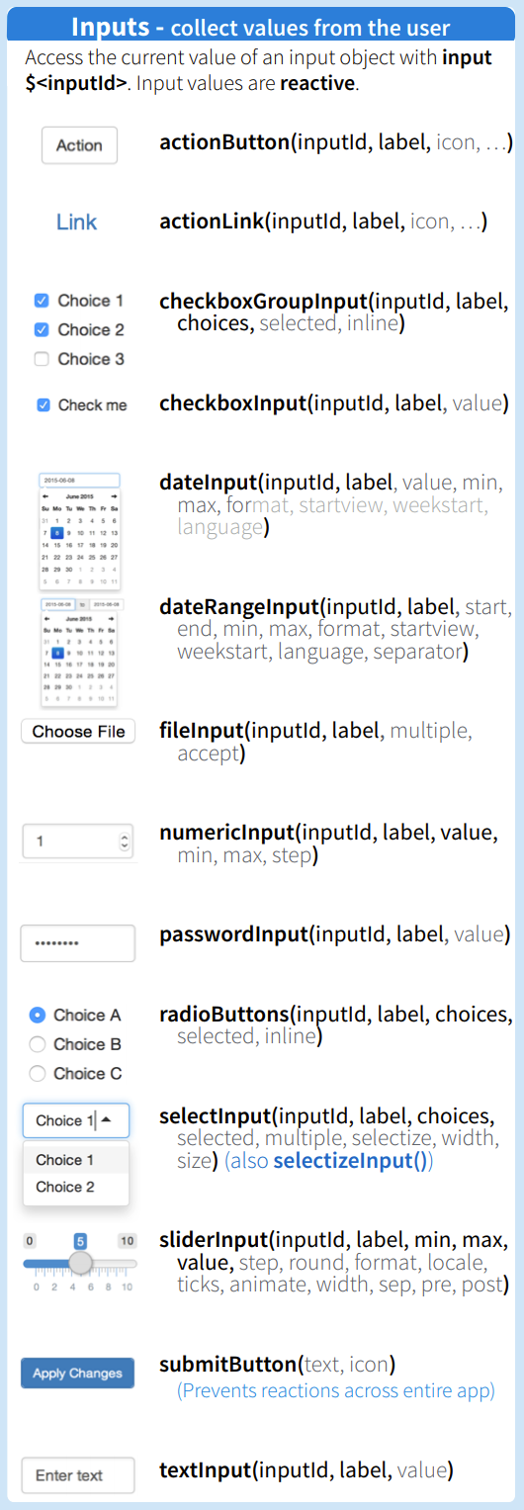
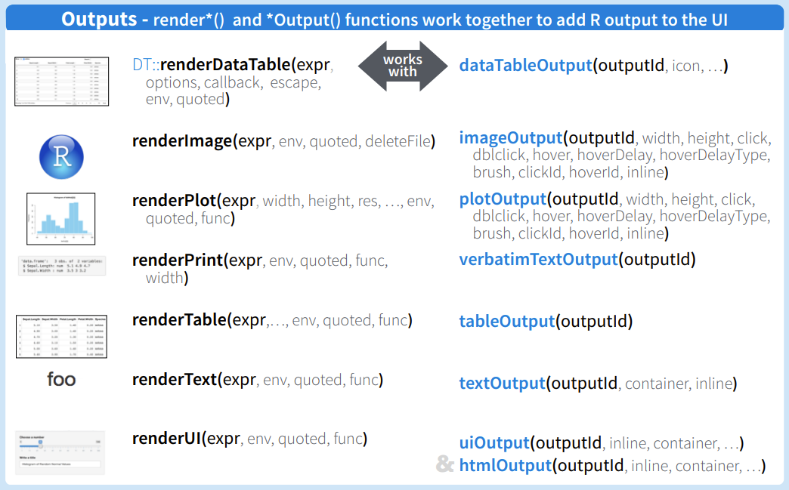
Great resource for reference is the Shiny Cheat Sheet at rstudio.com
Inputs:
Action buttons
Check boxes
Numeric or text boxes
Radio buttons
Sliders
Select from list
Outputs:
Data tables
Plots
Tables
Text
HTML
Source: https://shiny.rstudio.com/images/shiny-cheatsheet.pdf

Slide 17
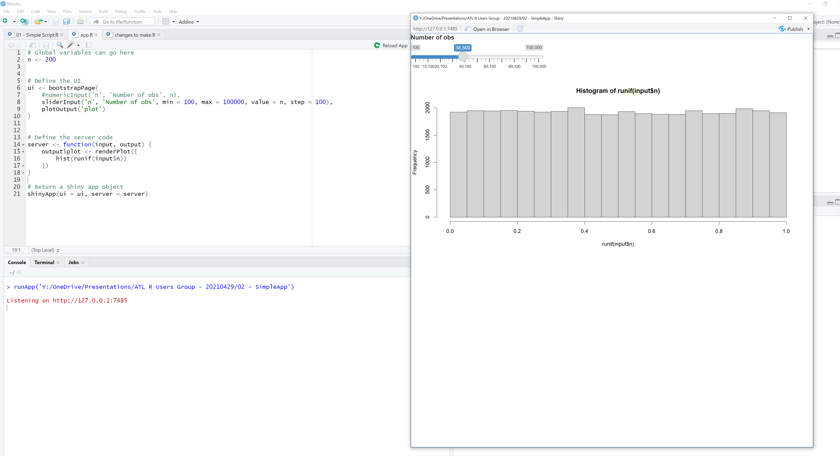
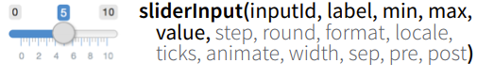
Change numeric input to slider input
Look at reference for sliderInput for arguments
Modify UI line – change numericInput to sliderInput

Slide 18
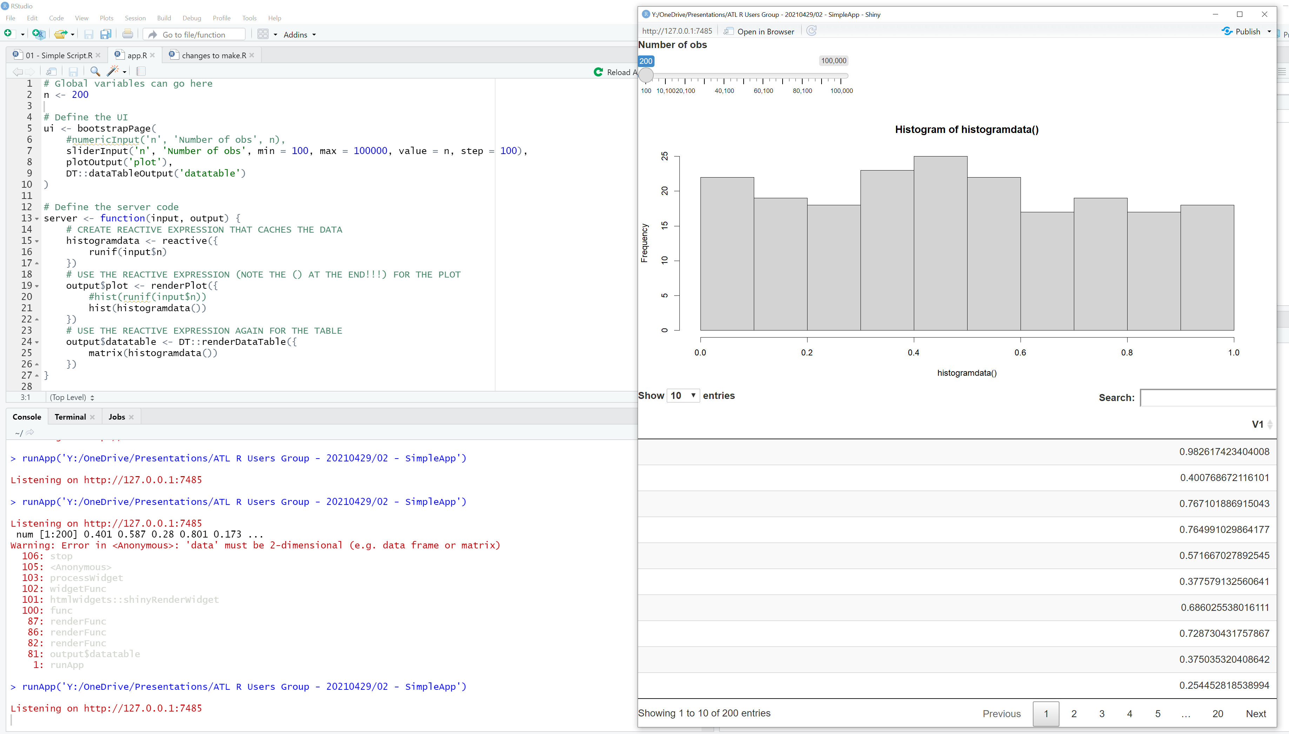
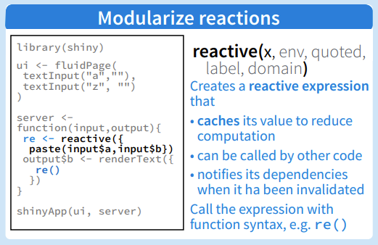
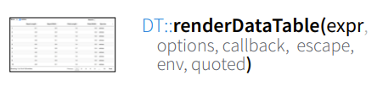
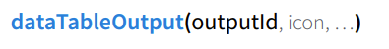
Add table that lists first 10 rows
More complex change:
Need to keep data in its own reactive expression so that more than one output can use it
Need to render an output table for possible display
Need to formally display table in the UI
Source: https://shiny.rstudio.com/images/shiny-cheatsheet.pdf

Slide 19
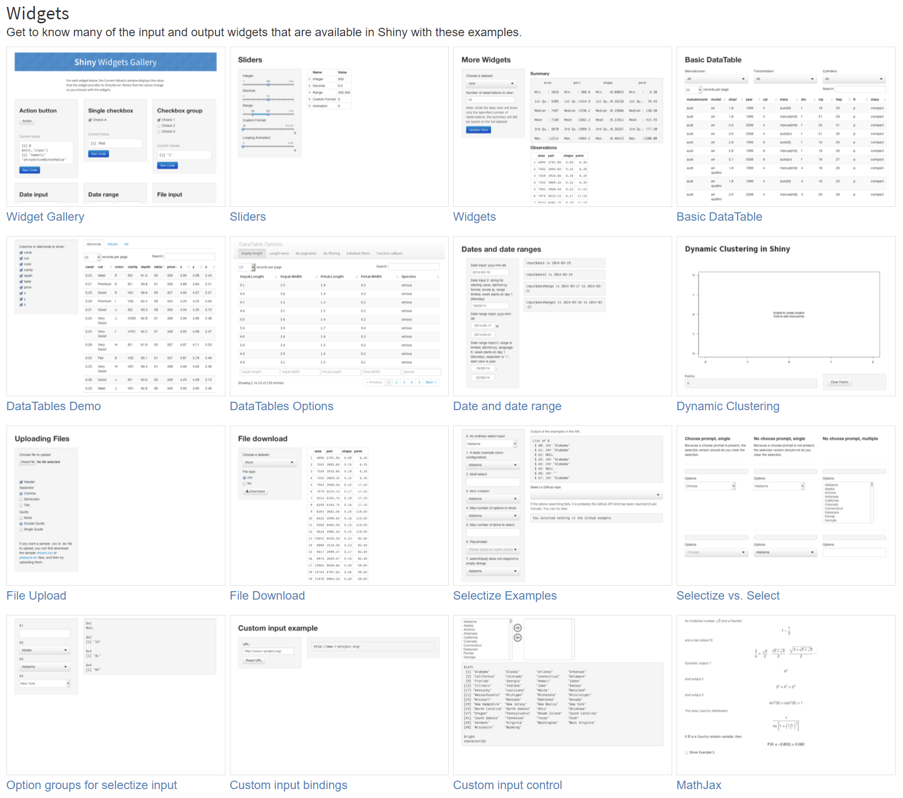
Great resource for reference is the Shiny Gallery at https://shiny.rstudio.com/gallery/
Examples of many of the input and output widgets, with code!
All are informative to see the potential for input/output options. We will briefly review the following:
Widget Gallery shows examples of all
Widgets shows an example of using an action button for signaling Shiny to make changes
MathJax shows how to embed equations

Slide 20
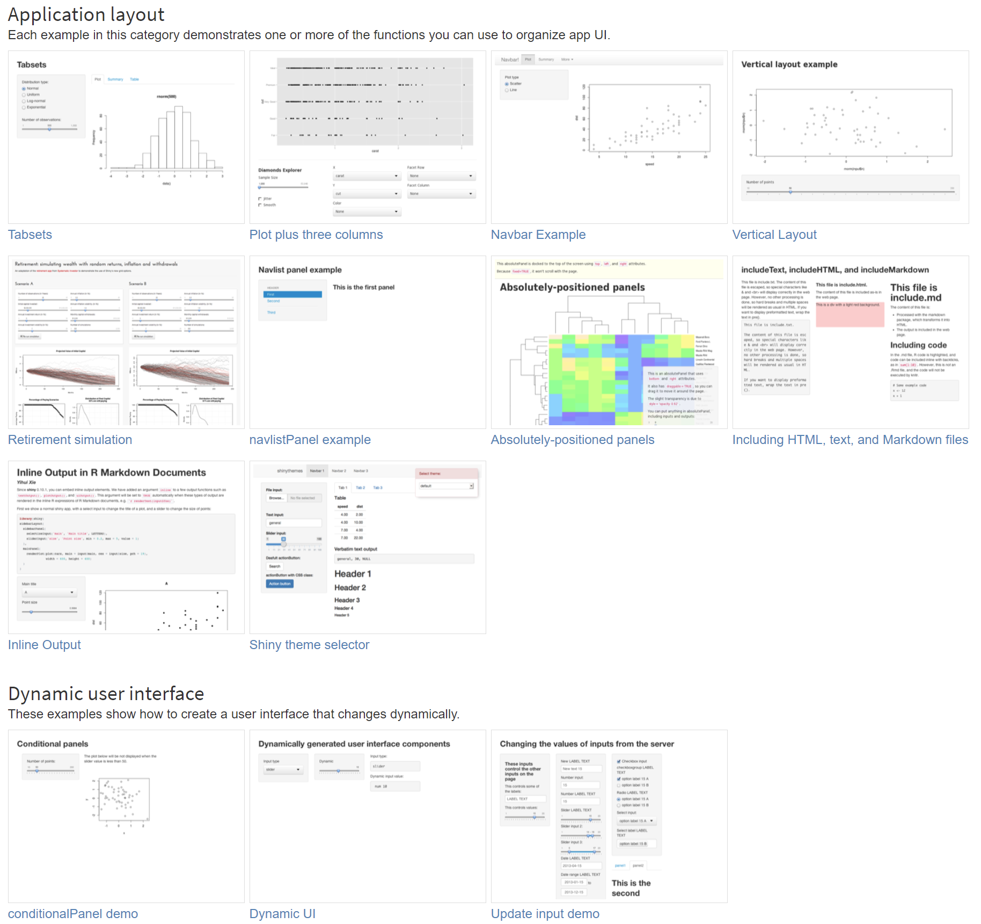
Great resource for reference is the Shiny Gallery at https://shiny.rstudio.com/gallery/
You have flexibility in how the UI looks and behaves as well!
All are informative to see the potential for ways to customize how the UI looks. We will briefly review the following:
Tabsets shows how to create a tabbed UI
Including HTML shows how to embed text and HTML into the app
Shiny Theme Selector shows examples of different themes available ready-to-go
Dynamic UI shows how to change the UI based on other inputs

Slide 21
Switch to Purchase Intelligence demo:
Deployed to Shiny Server Open Source
Tabbed UI
Action button example
Text, charts, etc. in output

Slide 22
Deployment Options

Slide 23
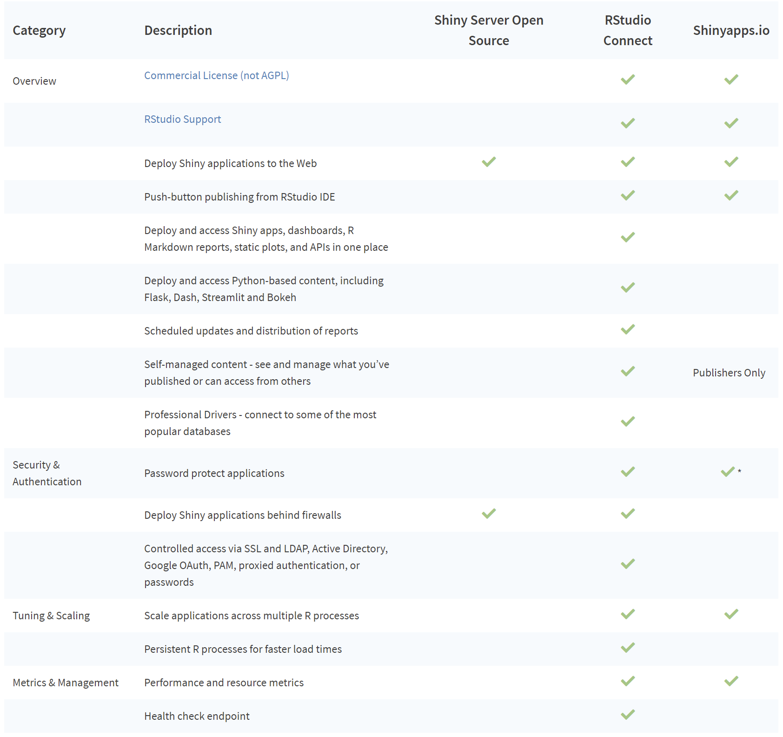
Several different options for deployment
https://shiny.rstudio.com/articles/deployment-web.html
RStudio Desktop
Deploy your code so that someone else can retrieve it and run the app on their RStudio installation
Shiny Server Open Source
Single-threaded
Scalability can be an issue
No auth mechanisms unless built into the app
Docker/Kubernetes work-around?
RStudio Connect
Commercial software
Many additional features!
shinyapps.io
Source: Shiny Server - RStudio

Slide 24
Additional Resources

Slide 25
More ways to learn
Shiny Cheat Sheet - https://shiny.rstudio.com/images/shiny-cheatsheet.pdf
Shiny Gallery - https://shiny.rstudio.com/gallery/

Slide 26
More advanced topics to learn
Making your UI look better:
Themes - https://shiny.rstudio.com/articles/themes.html
Incorporating HTML - https://shiny.rstudio.com/articles/html-ui.html
Making your code run more efficiently:
Truly understanding observe/control reactivity -
Global variables for shared use –
Plot caching - https://shiny.rstudio.com/articles/caching.html
Profiling functions - https://shiny.rstudio.com/articles/profiling.html
Reducing bottlenecks - https://shiny.rstudio.com/articles/performance.html
Asynchronous programming - https://shiny.rstudio.com/articles/async.html

Slide 27
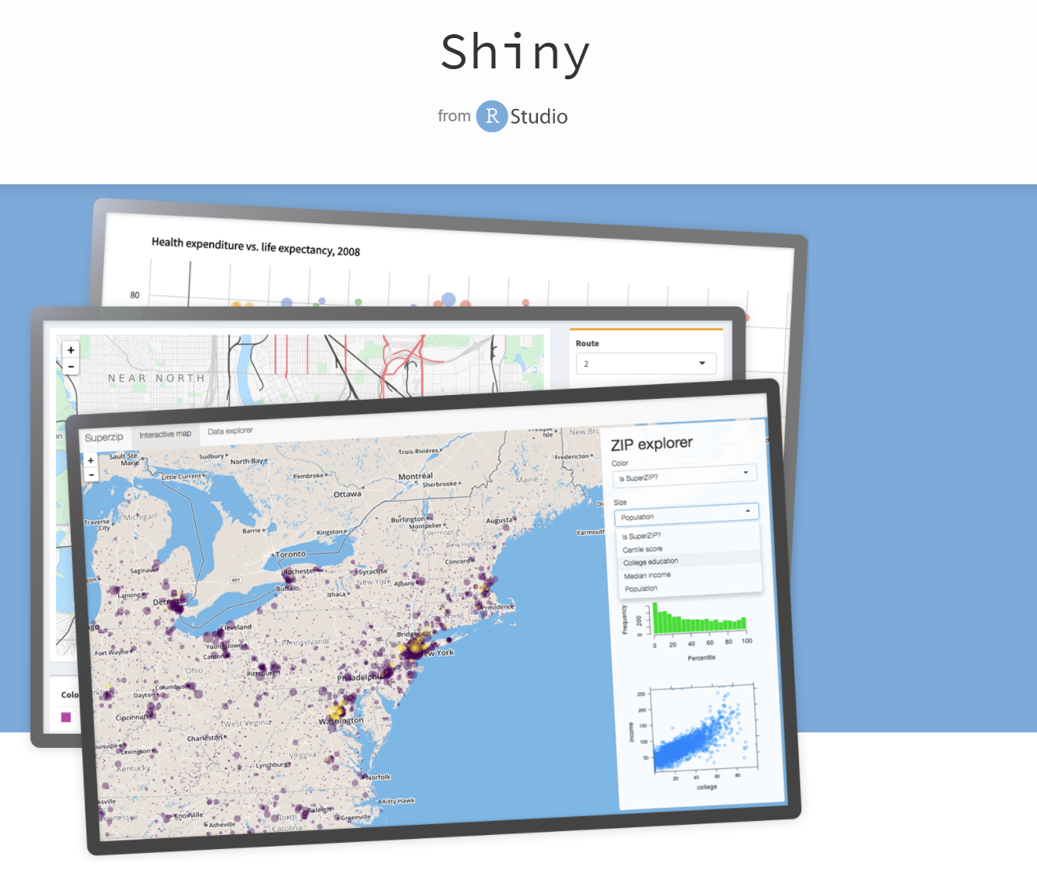
Thanks!
Hope you got an idea of what R Shiny can do and how you can learn more…

